Slide 1







Jen Thum
Brown University
Notes:
I study ancient Egyptian living-rock stelae.
Stelae:
Living rock:
And I study these from the perspective of landscape archaeology. What do I mean by that?

Slide 2
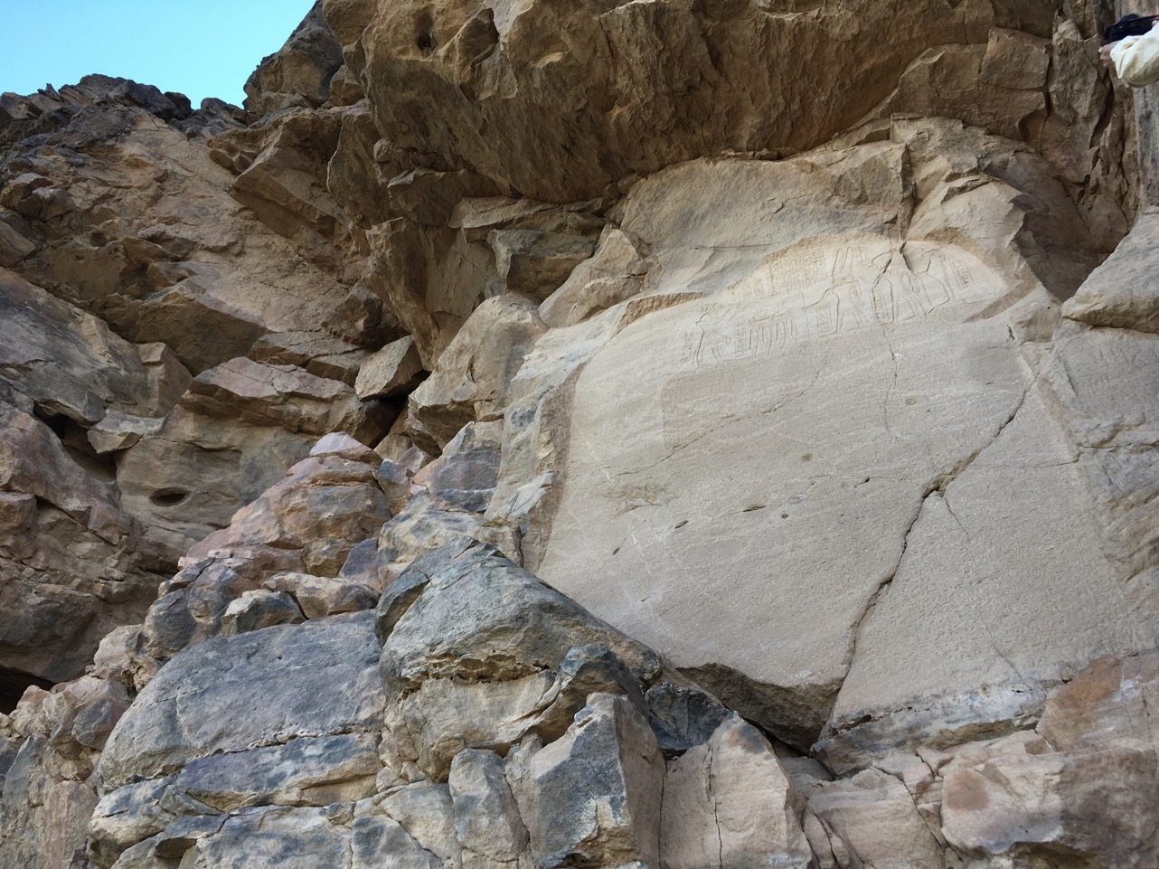
Notes:
Well, for example, here’s one of the stelae at a site in Sudan called Nauri. In the past Egyptologists have only cared about the text and epigraphic details…

Slide 3
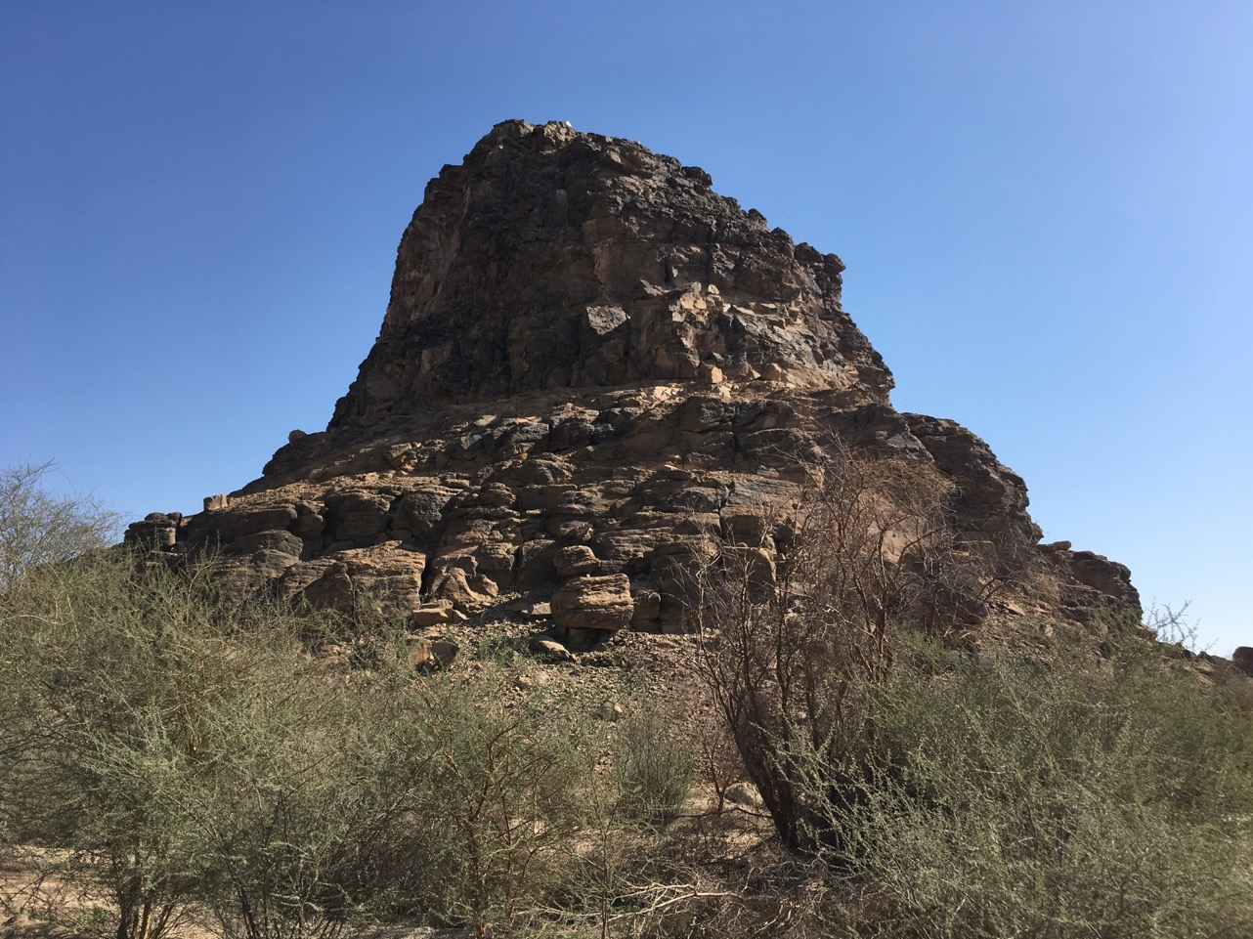
Notes:
…but I care about its local setting, which as you see when I zoom out, is actually this sandstone butte…

Slide 4
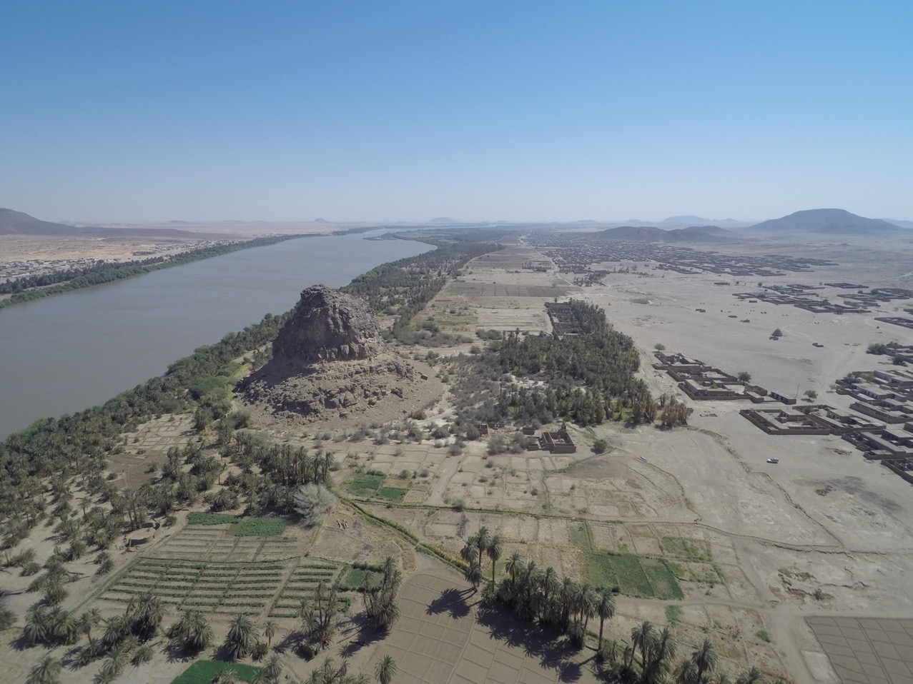
Notes:
…and I care about its wider landscape, too, which as you can see here has no similar features; the butte is also located right along the Nile, a trade corridor mentioned in the text of the stela.
So I’m interested in the materiality and setting of these monuments, because I want to know why the medium of living rock—which is stuck to the places where it is, and so—why these landscapes were used to make this particular type of monument.
And I use drone aerial photography, GIS, photogrammetry, and a handful of other technologies to try and answer this question.

Slide 5
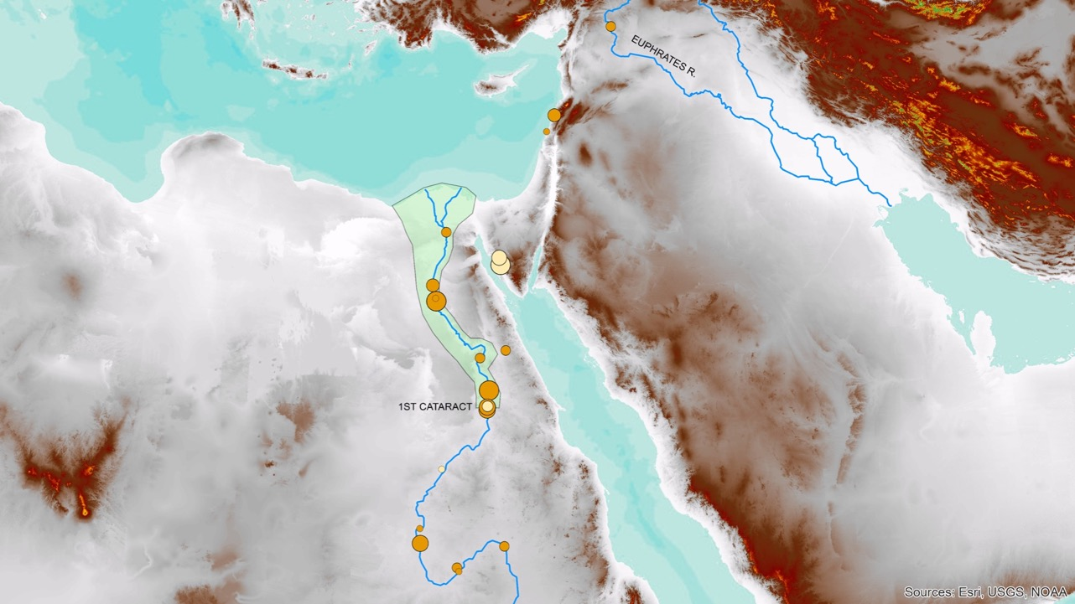
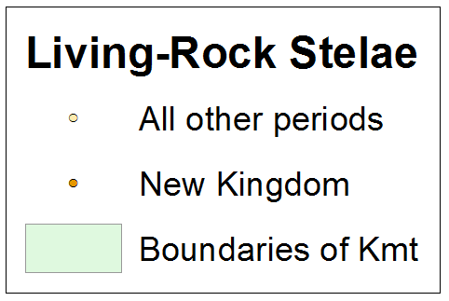
Notes:
I am using GIS to map these stelae on a regional scale; as you see here they cluster at the borders of the Egyptian empire, all the way out into modern Sudan and Lebanon, and also at the time of the New Kingdom, when Egypt’s empire was at its greatest extent.

Slide 6
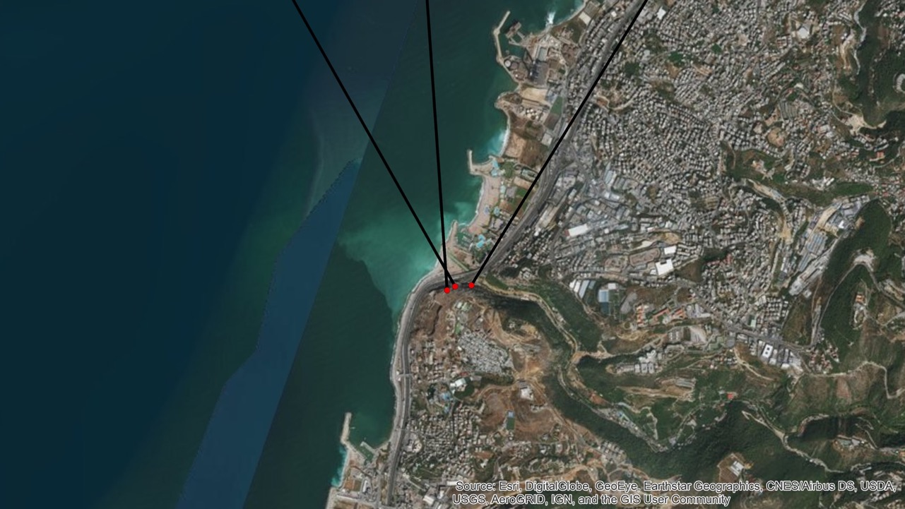
Notes:
On a smaller scale, I’m also interested in sightlines and viewsheds—GIS applications that give me a sense of whether or not the orientation of a stela and its rock face was meaningful.

Slide 7
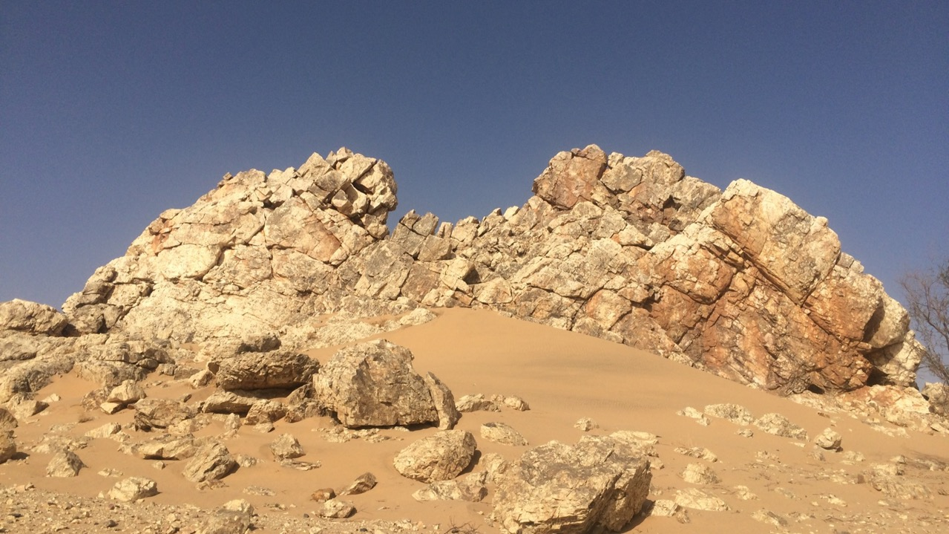
Notes:
This includes modeling the “monumentality” of an outcrop by looking at its shape, geological, topographic, and visual prominence in the surrounding landscape and the angle at which a viewer needs to crane his or her head up to see it—all established elements of “monumentality” as identified by the architectural theorist Tadahiko Higuchi.

Slide 8
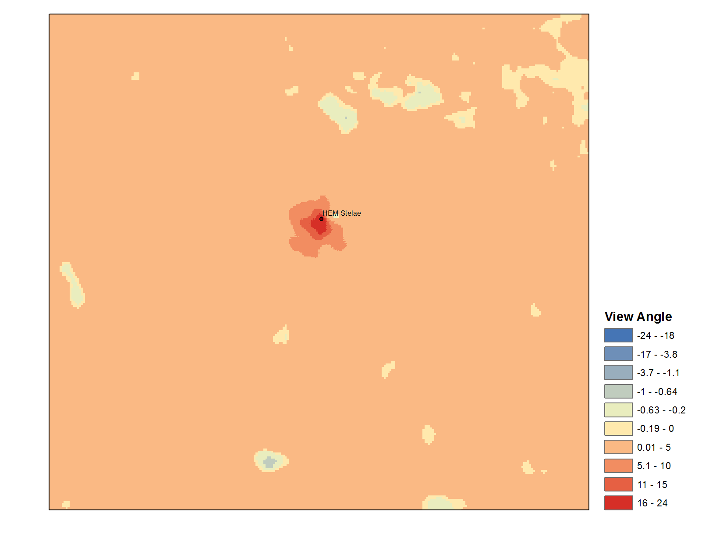
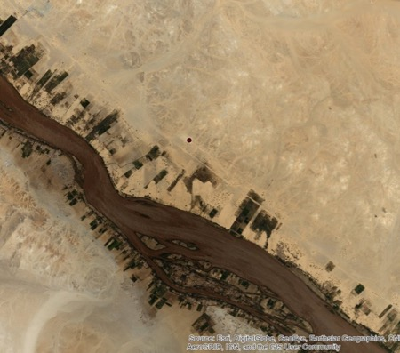
N
HEM Stelae
Courtesy of Chris Angel (Center for Advanced Spatial Technologies)
Notes:
The Python script used to model this was created by Chris Angel at the Center for Advanced Spatial Technologies at the University of Arkansas. I am collaborating with them because I have an award from the Center through an NSF-funded program called SPARC, where they lend me equipment and personnel to help me do my fieldwork. That’s how I’ve avoided bringing Brown’s own drones to these places; I’ve been using theirs instead!

Slide 9
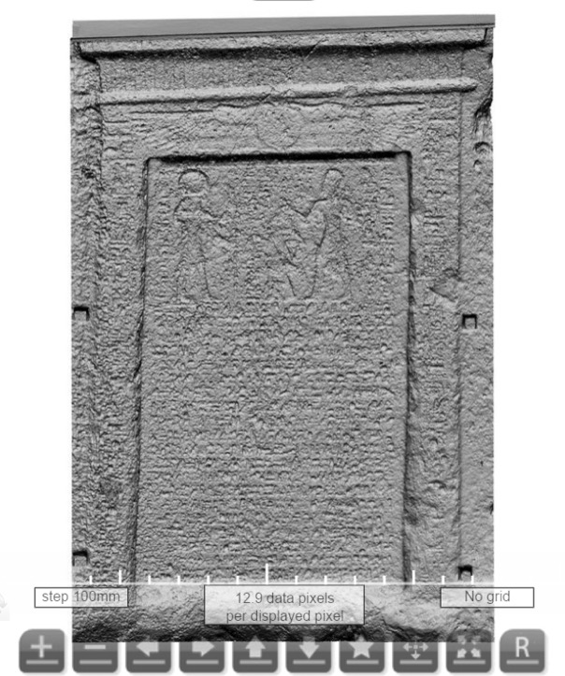
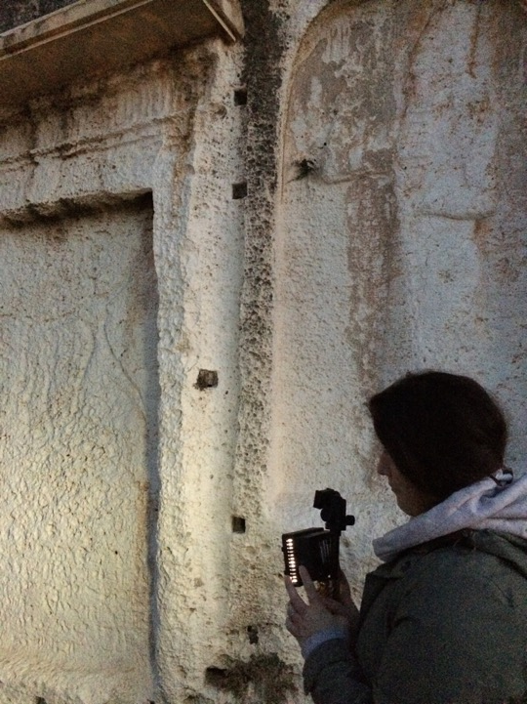
© Factum Arte
Night-time RTI
Notes:
On an even smaller scale, I sometimes get the chance to do some Reflectance Transformation Imaging (RTI) on the stelae themselves. (Does everyone know what RTI is? OPEN ONE UP???)
On the right is an image produced with a laser scanner as part of my collaboration with Factum Arte, a heritage preservation organization.

Slide 10
Notes:
Another layer of my work involves looking at archival photos of landscapes that have changed in modern history, because the prominence of the outcrop where a stela was carved may not be what it was in antiquity today. I’ll give you one example…

Slide 11
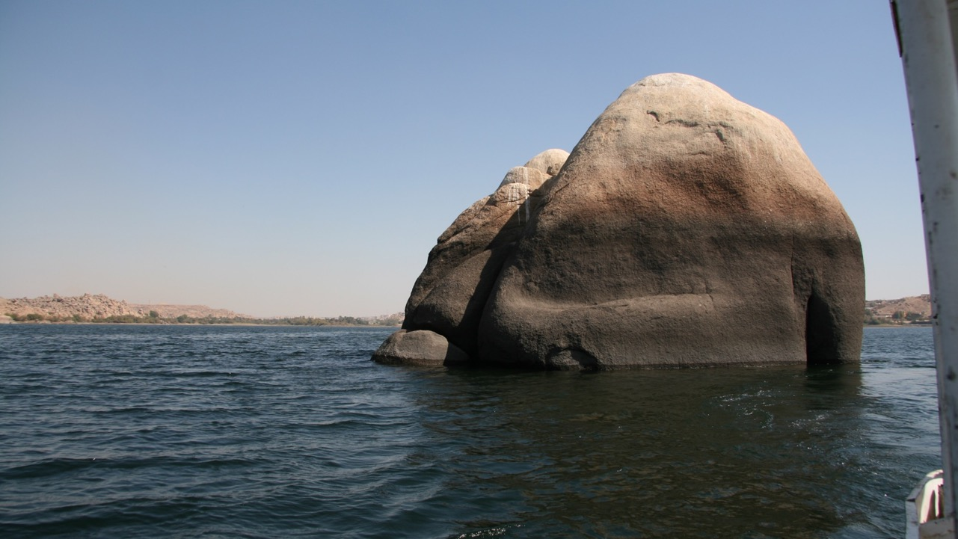
Notes:
This is Konosso Island in Egypt’s southern Nile Valley. In order to see it I had to hire a boat.

Slide 12
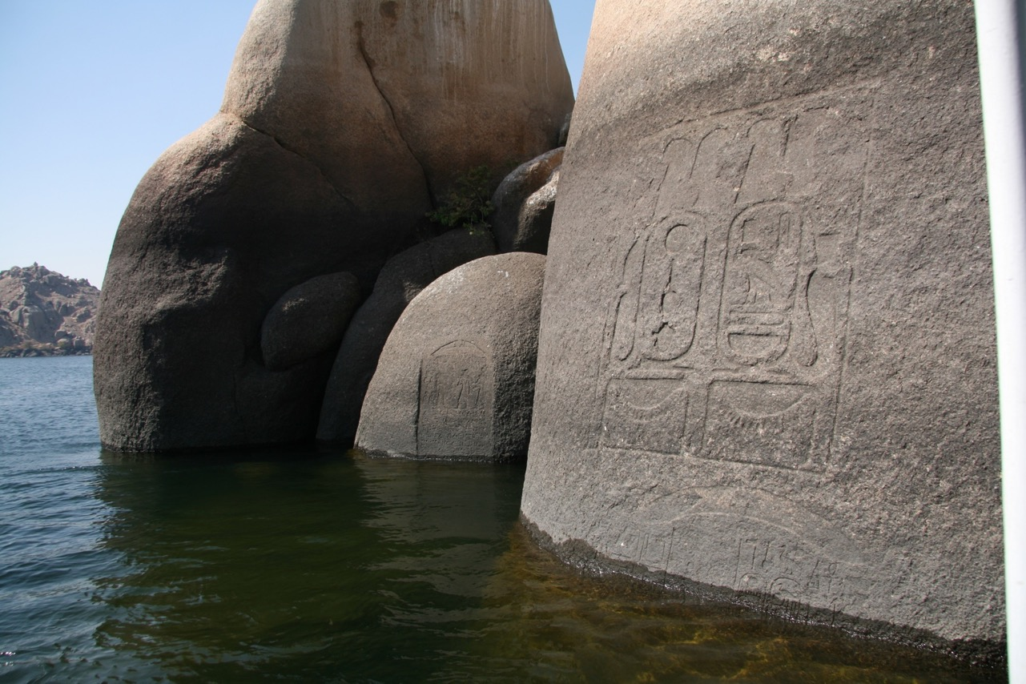
Notes:
There are several royal stelae on this island, mostly submerged now.

Slide 13
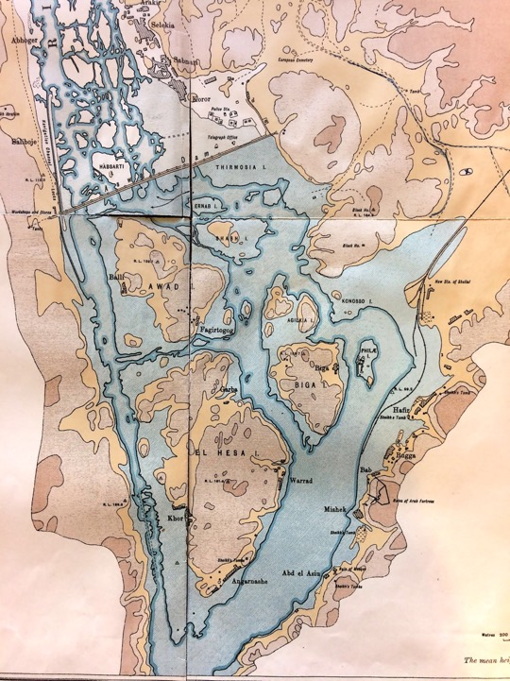
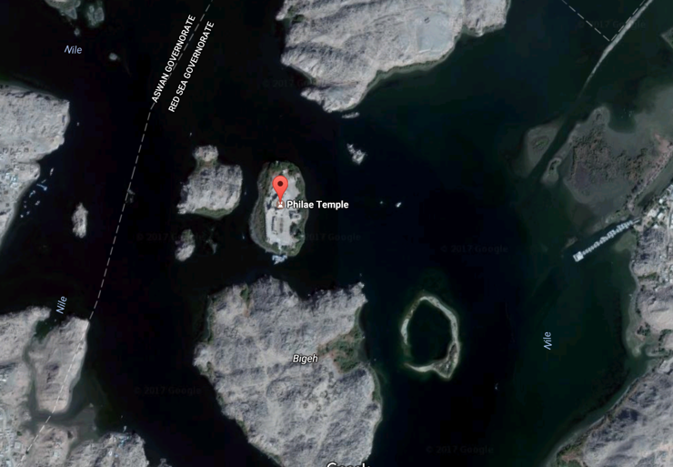
Ball 1907
Notes:
I drove myself crazy trying to understand why these stelae were carved on this particular island, ANIM this teeny-tiny island, when there are SO MANY ISLANDS in this area, several of which contain important architectural remains.
…and then I found the archival photos. This landscape has changed dramatically since the construction of the Aswan Dam, which flooded the area. But in the case of these stelae, it’s obscured more than I expected.

Slide 14
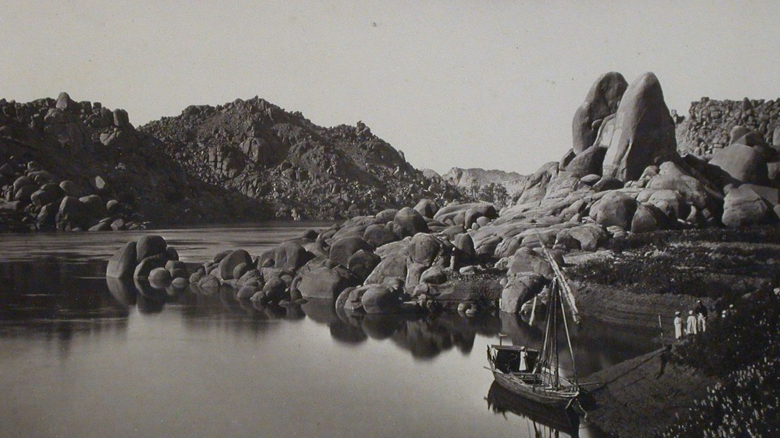
© Canadian Centre for Architecture
Notes:
THIS ANIM is what that island used to look like. Not much of an island, in fact—it only used to be an island during high water.
This isn’t the ancient landscape, but it’s closer than what we have now. Here are two rock peaks rising from the land mass, almost like a pylon. Of course this is the best place in the area to make your stela!

Slide 15
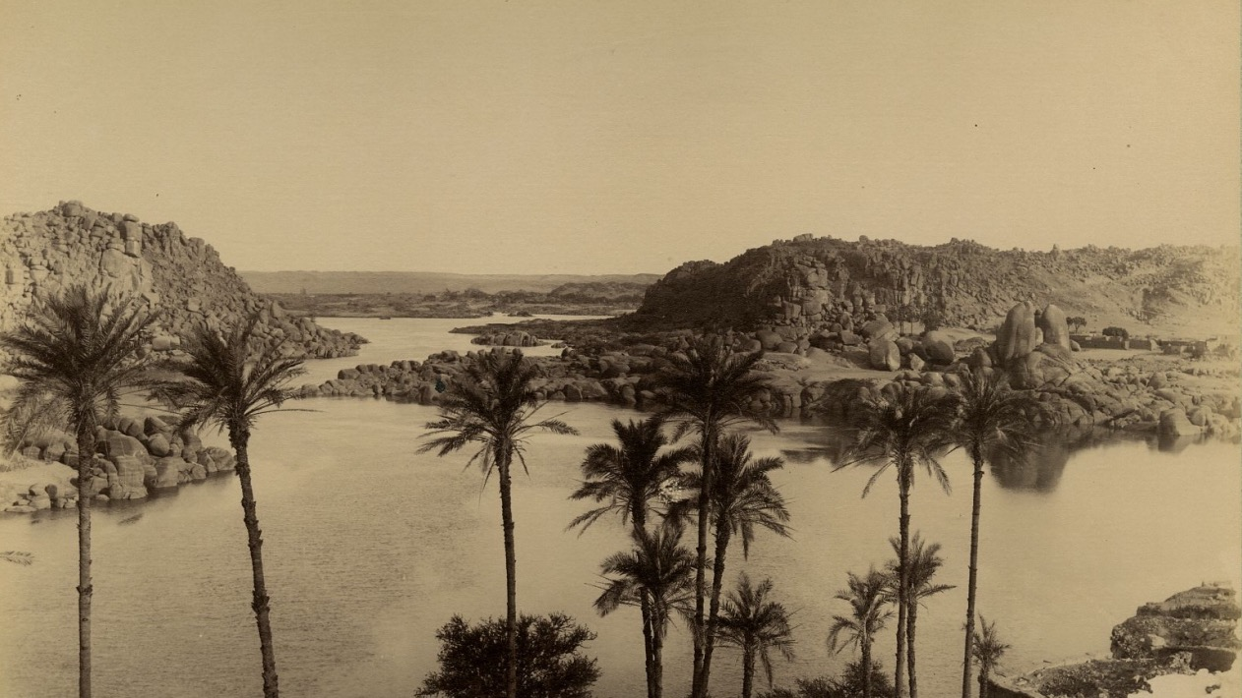
© J .P. Sebah
Notes:
Here’s another view with more of the wider landscape around it.
And this, my friends, is why landscape is important—not just the text of the stela that was carved into that landscape.

Slide 16
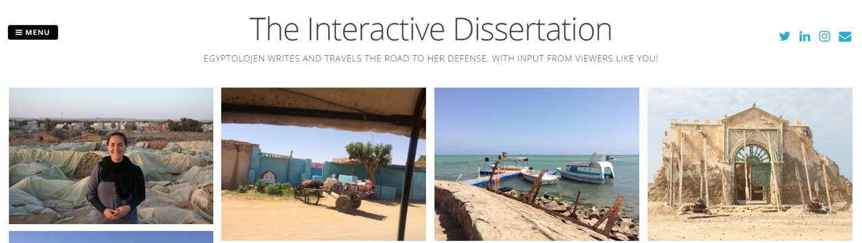
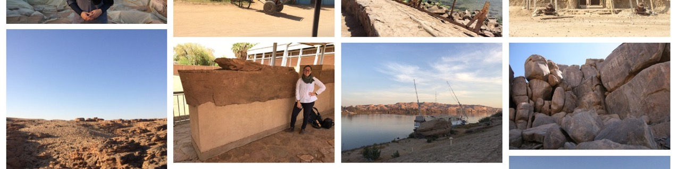
brown.edu/go/egyptolojen
@egyptolojen
Notes:
One final element of my work is an outreach project that I started in order to bring these faraway, often forgotten monuments and landscapes to the public as a teaching tool. It’s called The Interactive Dissertation.

Slide 17
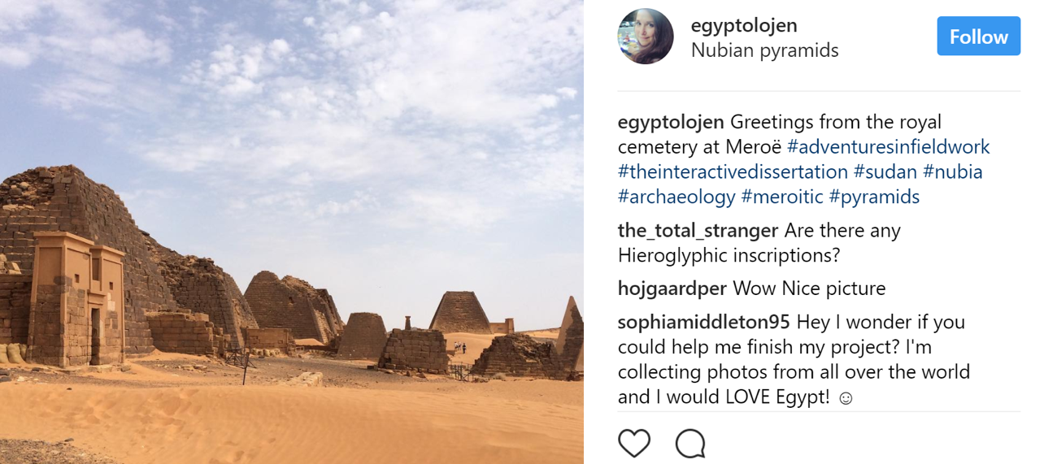
Notes:
In it, I use Twitter, Instagram, and the Brown Blog you just saw the link for on the last slide to encourage questions and comments about my work and the material I study.m

Slide 18
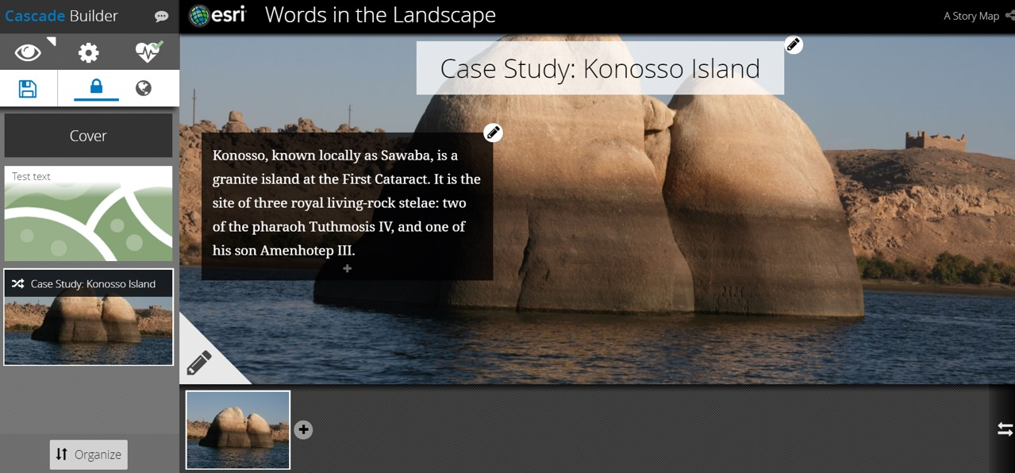
Notes:
An extension of this, with CDS, is my in-progress work with our GIS Specialist Bruce Boucek to create an ArcGIS Online StoryMap for public consumption.

