Slide 1
Being an Undergrad in Digital Scholarship
Margaret Follett
Brown ‘19
11/09/2017

Slide 2
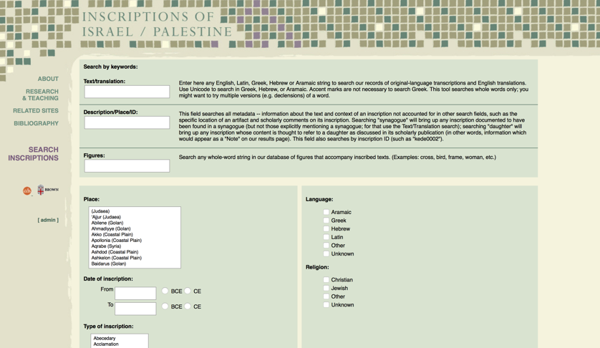
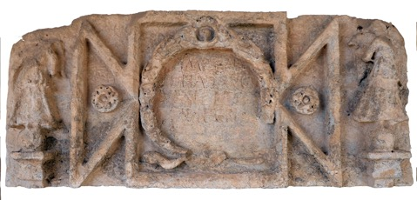
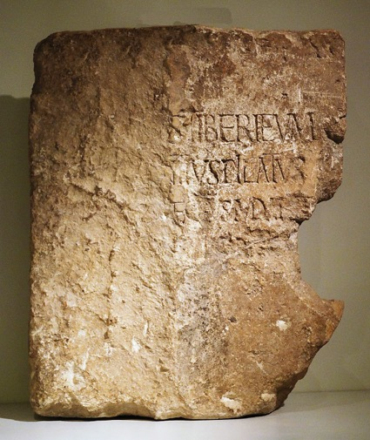
Inscriptions of Israel/Palestine

Slide 3
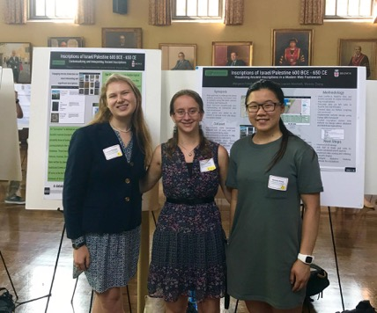
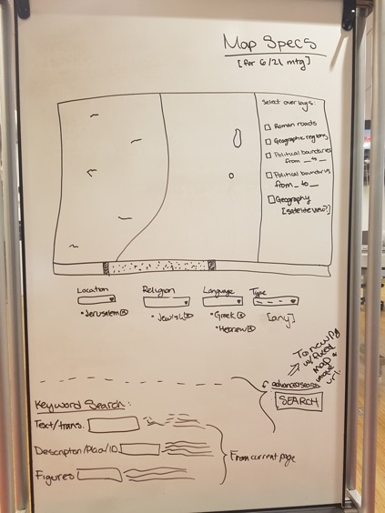
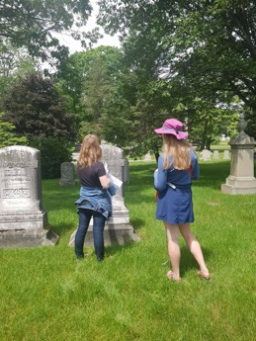
The iUTRA
Four interdisciplinary undergraduates
10 weeks; summer 2017
Goals: accessibility and context

Slide 4
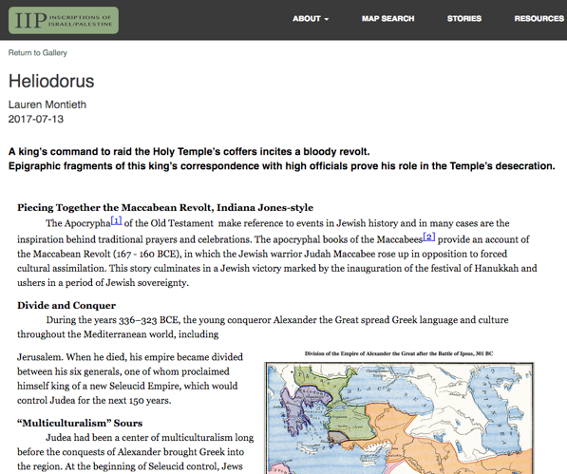
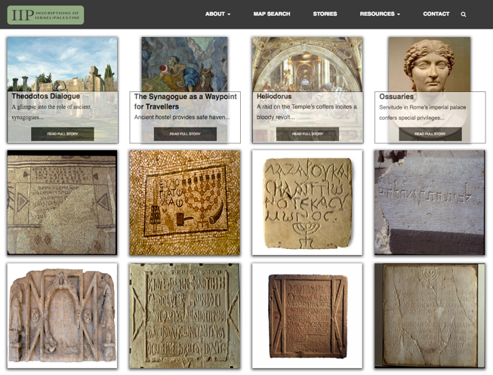
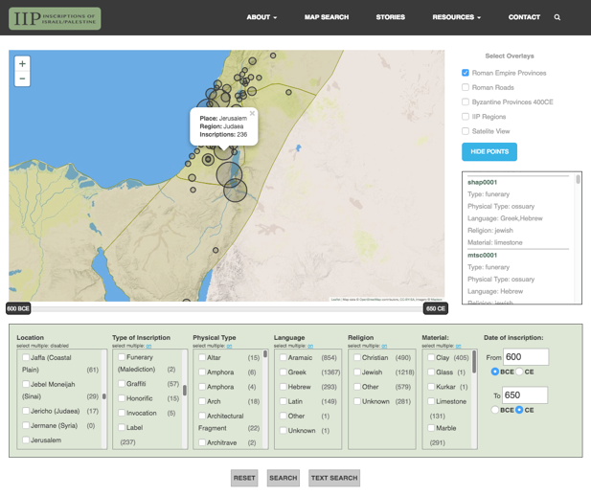
Projects
Narrative writing
Interactive map
Content “guides” i.e. glossary, about
Rabbit trails
http://library.brown.edu/iip_development/mapsearch/

Slide 5



Resources
People – amazing discussions, feedback on ideas, etc.
Workshops
Software
Space

Slide 6
Difficulties
Differing opinions (internal and external to group)
Joining a long-term project with turnover
Scope and accepting defeat…

