Slide 1
About Me
Alexa Little
BA: Yale 2016, Linguistics
Focus on computational linguistics, endangered languages
Executive Director of 7000 Languages
“connect communities with the technology to teach, learn, and revive their languages”
www.7000.org

Slide 2
The Digital Divide
7099 languages spoken worldwide…
140 languages in Microsoft Word (< 2%)
102 languages on Google Translate (< 1.5%)
47 languages supported on Android (< 1%)
31 languages supported on iOS (< 0.5%)

Slide 3
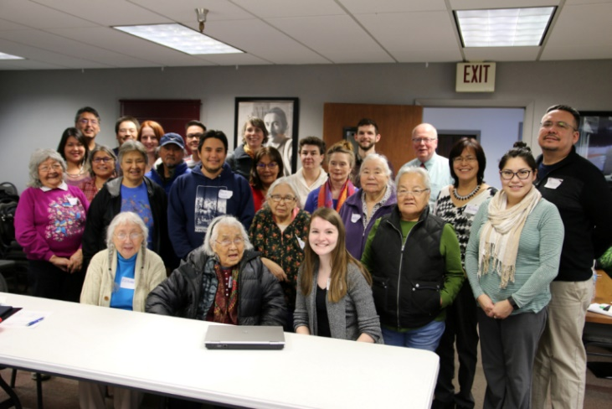
Why it matters:
Historical context
Community health
Educational outcomes
Cultural heritage
Science
Equality

Slide 4
What can we do?
Data Science,
Computer Science
Digitization
Archives Data Technology

Slide 5
2015: The Cherokee Singing Book

Slide 6
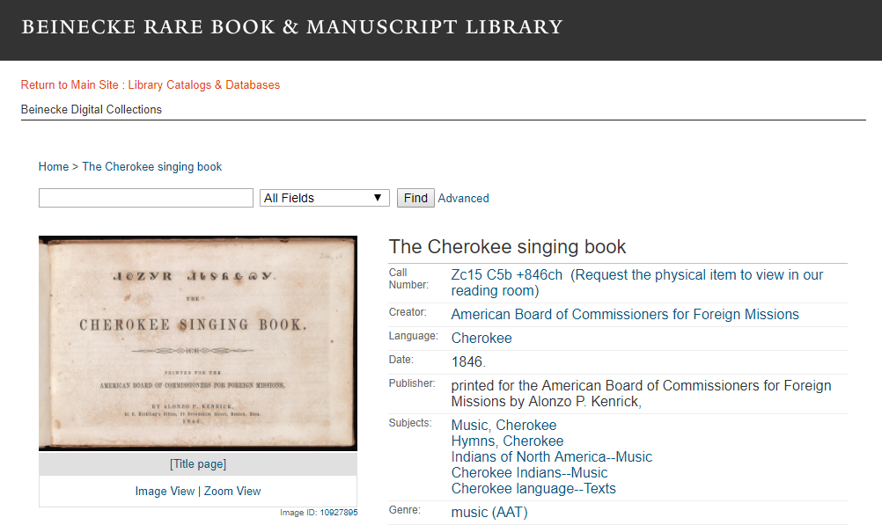

Slide 7
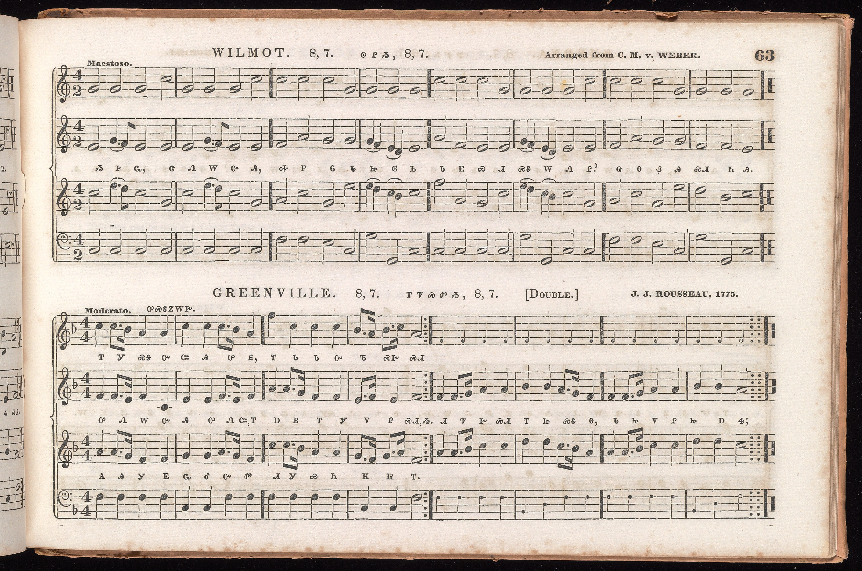

Slide 8
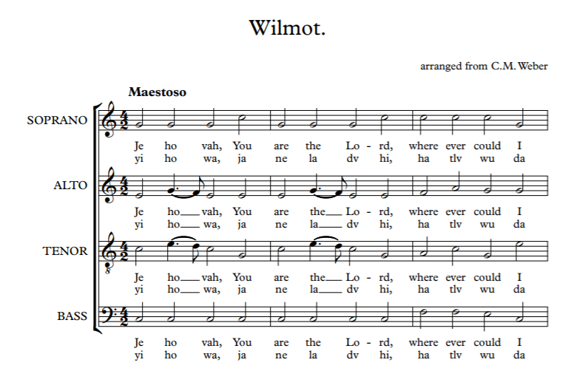
No Cherokee support in Sibelius… future work?
Full score and each part can be extracted as PDF, played as midi/mp3
Translation assisted by Tom Belt, Hartwell Francis

Slide 9
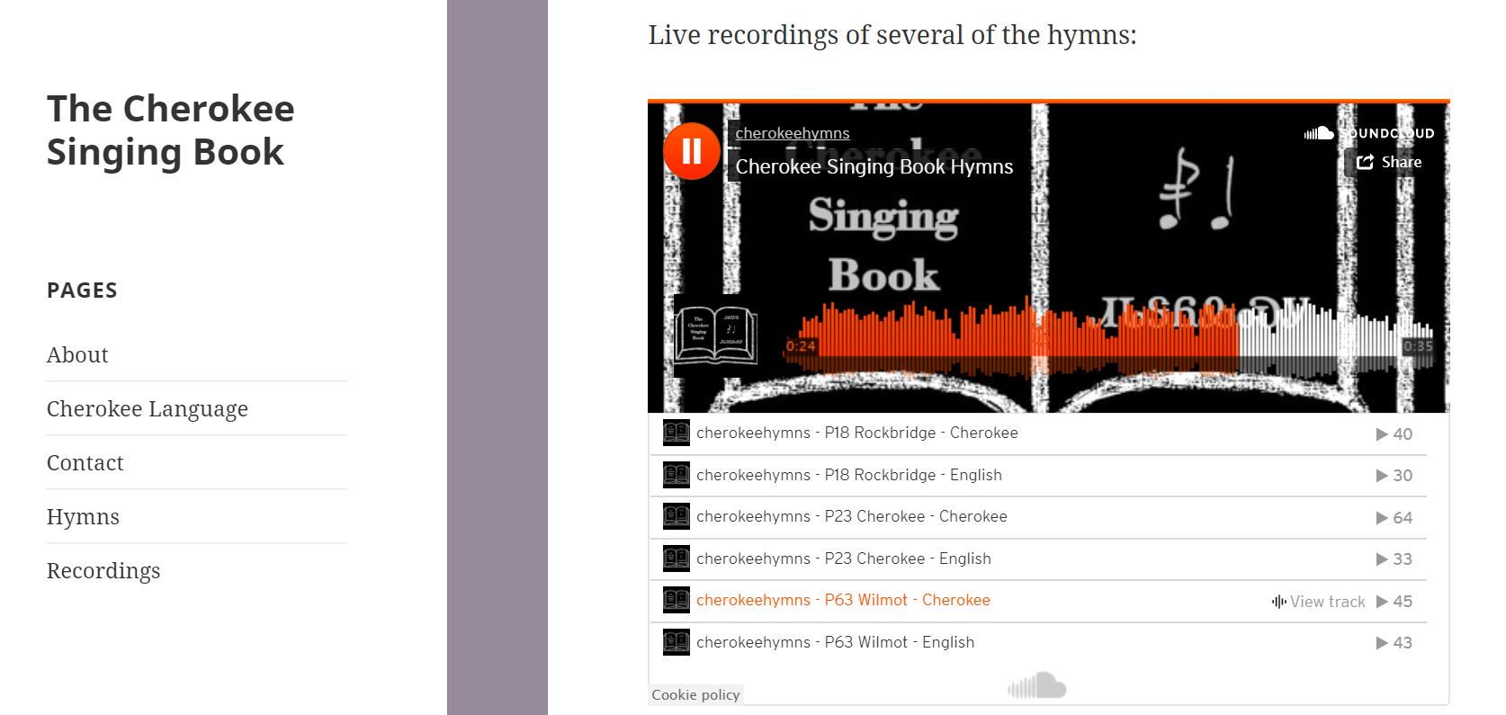

Slide 10
2017: The Kilpatrick Collection
(Proof of Concept)

Slide 11
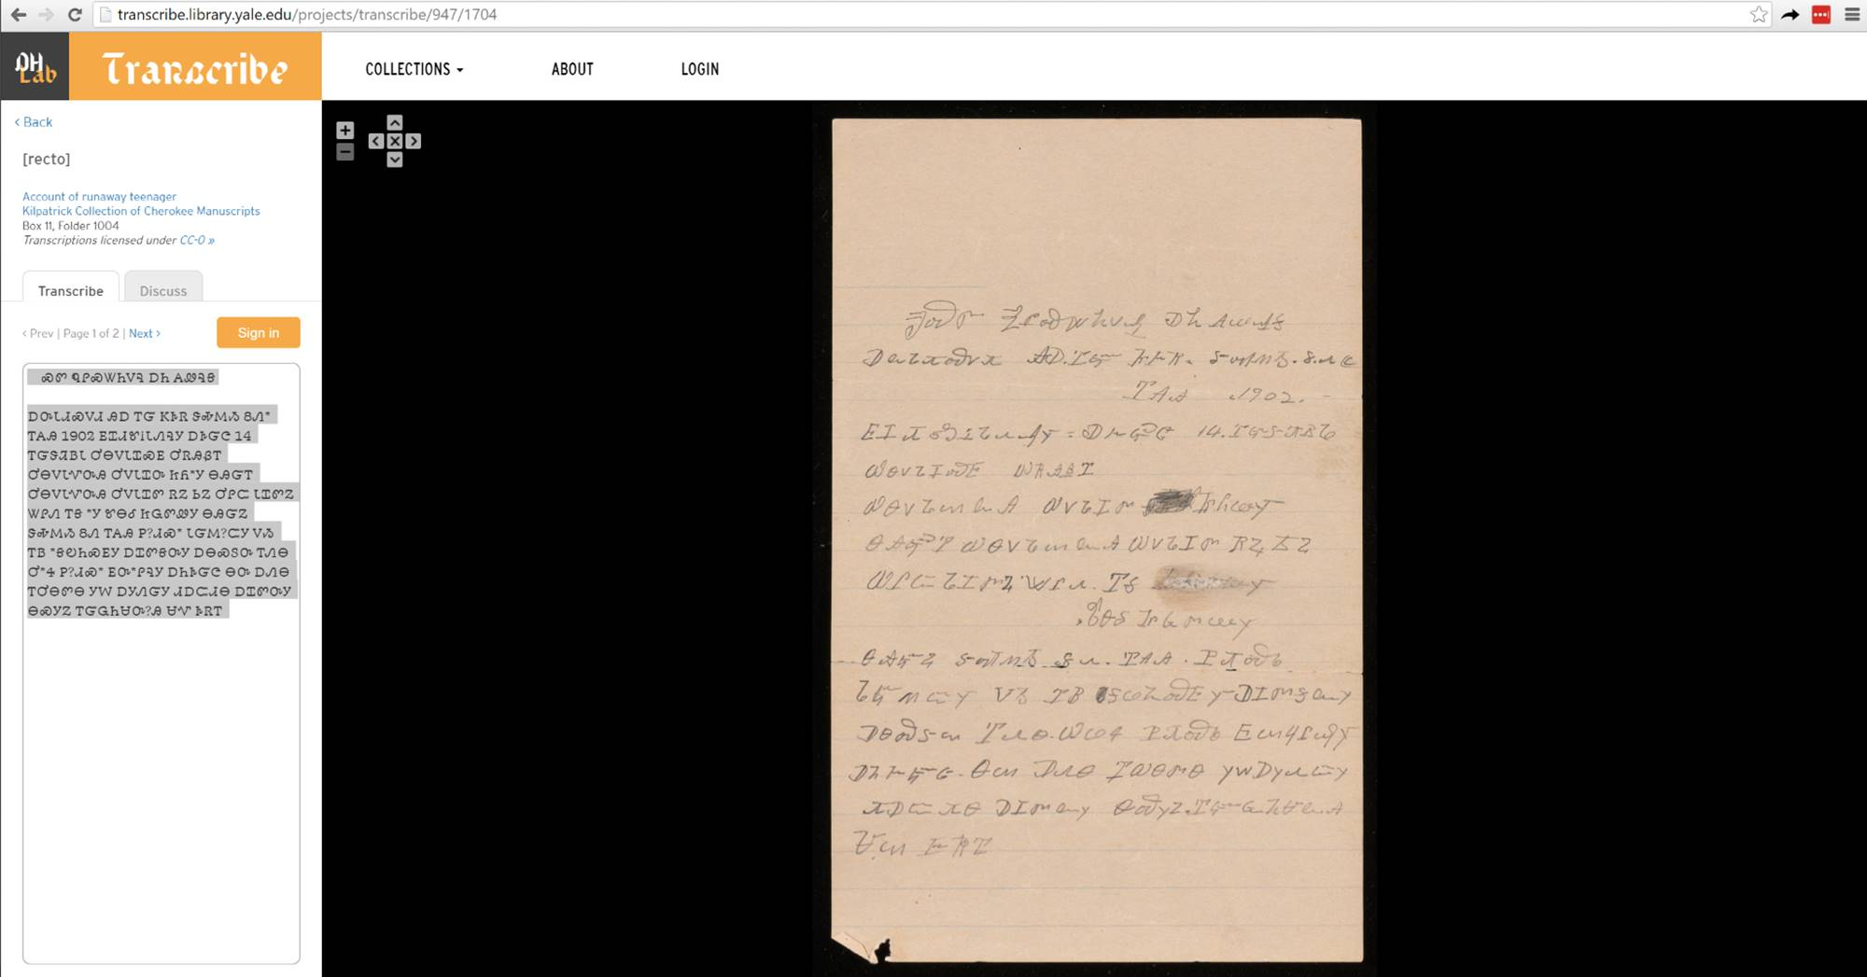

Slide 12
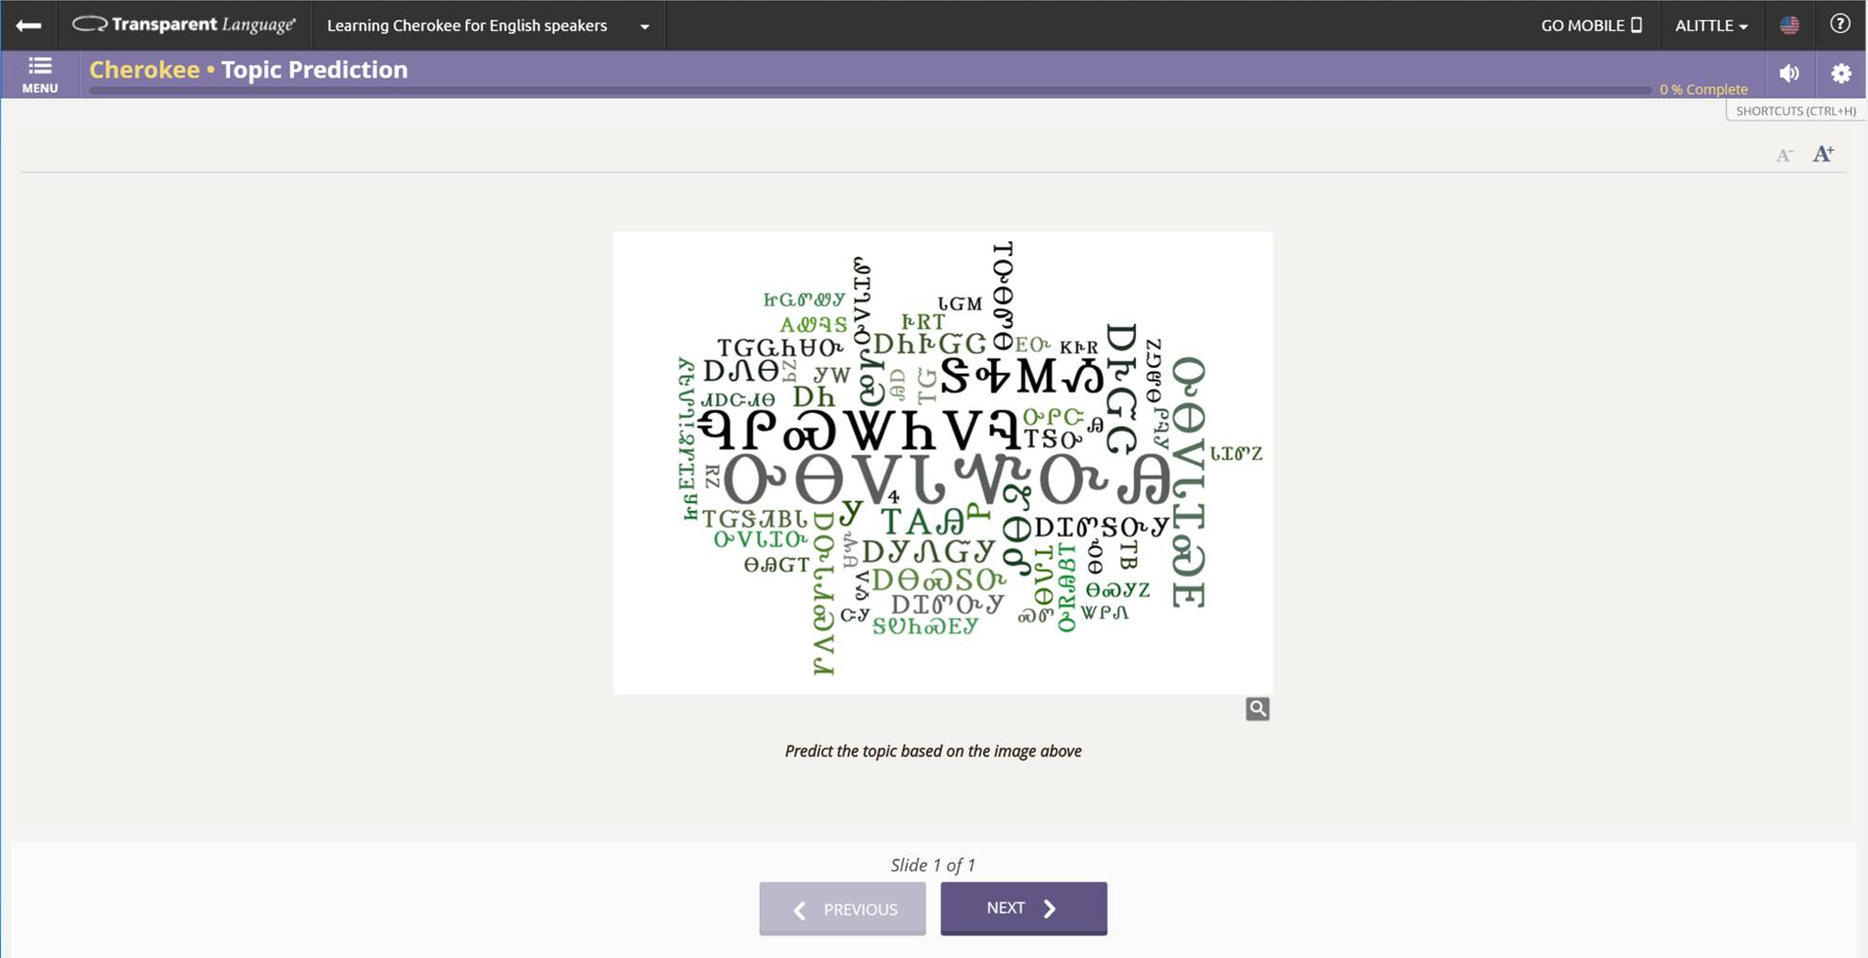

Slide 13
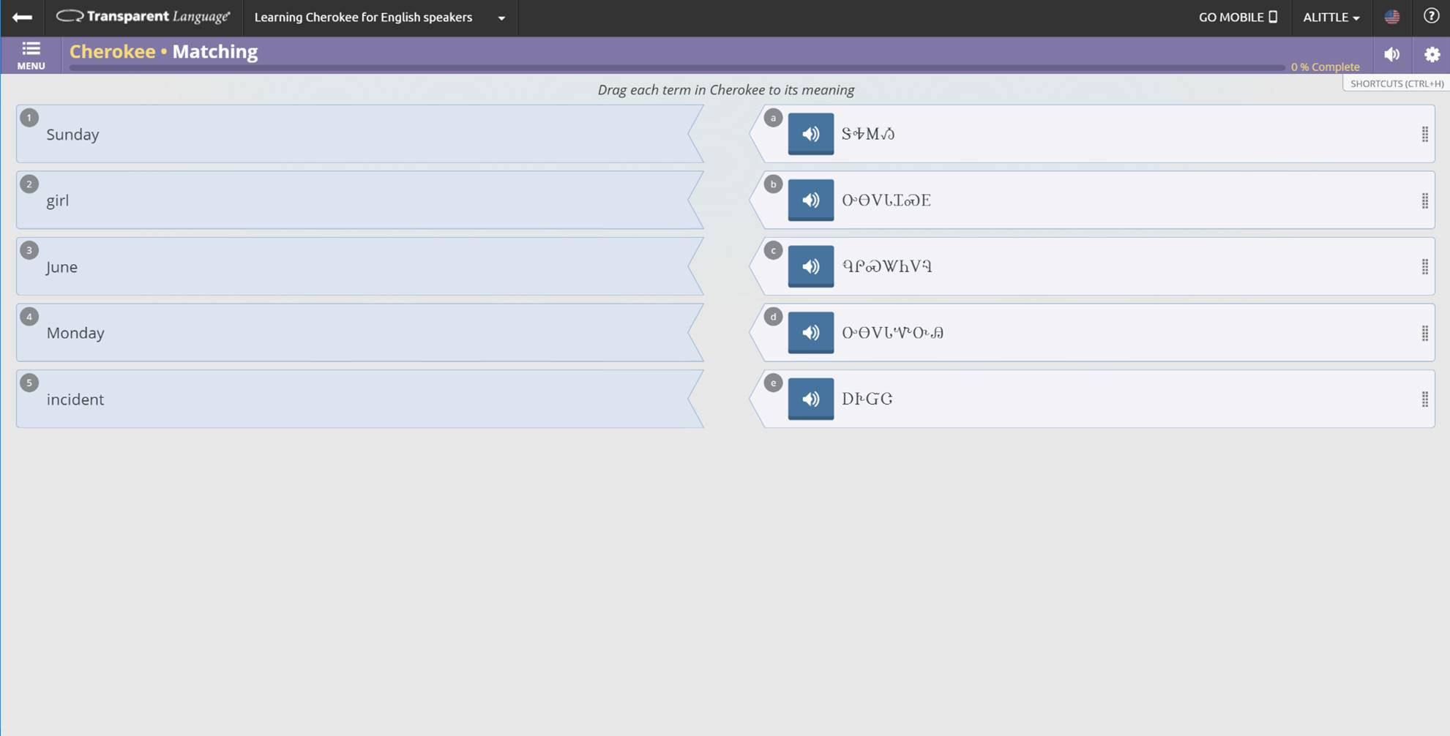

Slide 14
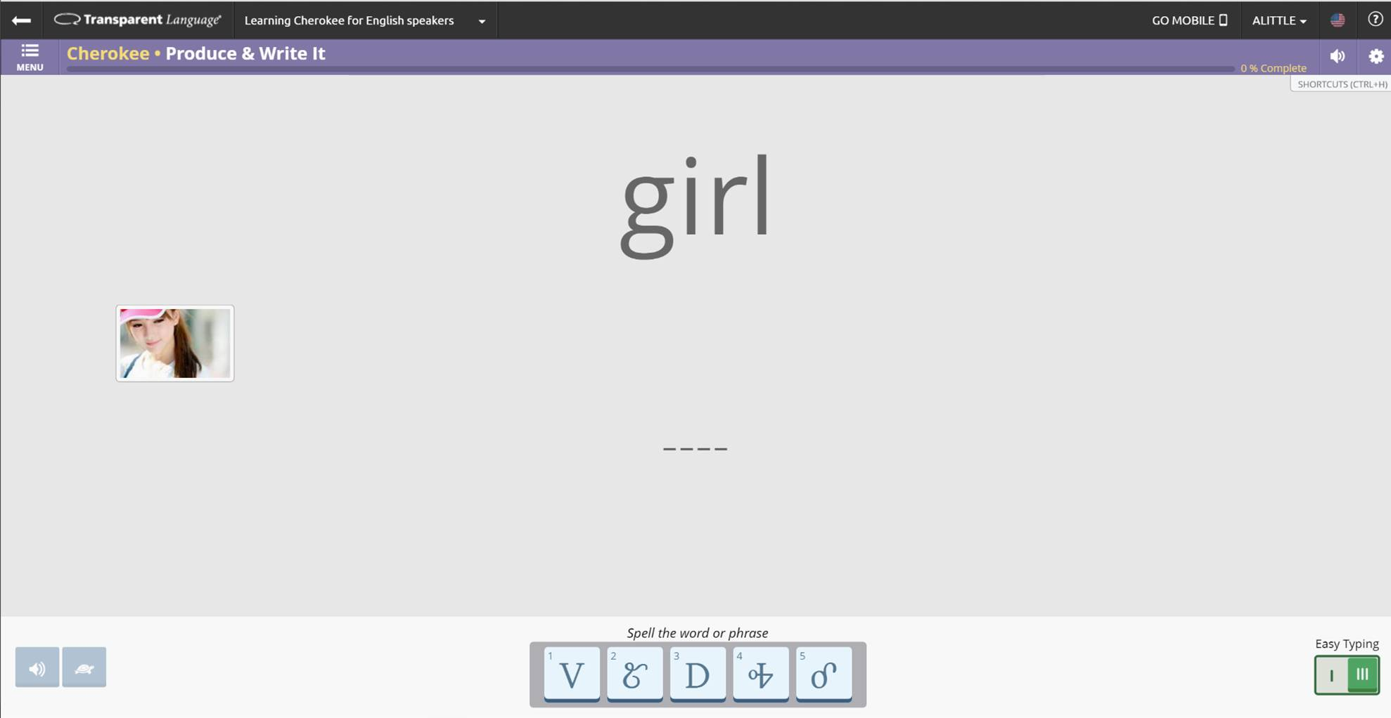

Slide 15
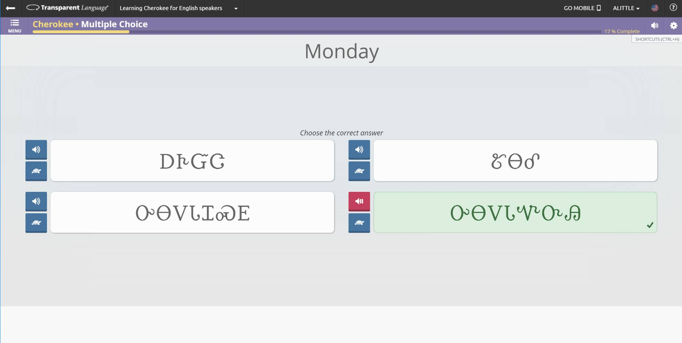

Slide 16
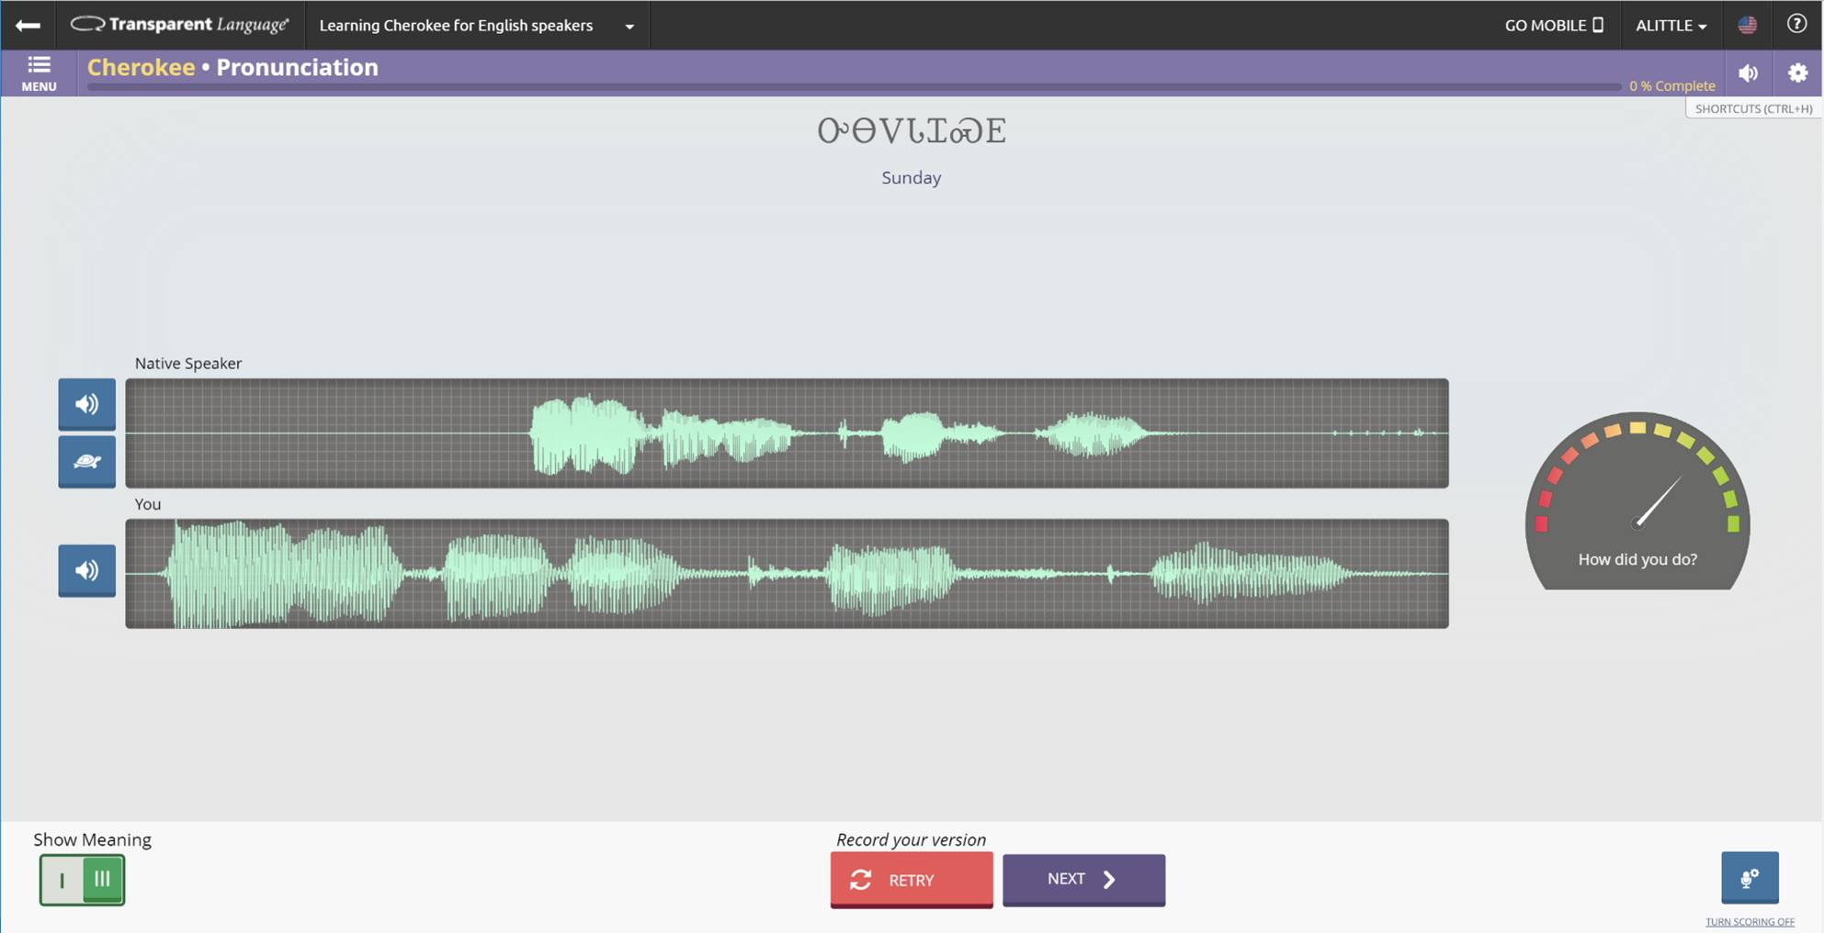

Slide 17
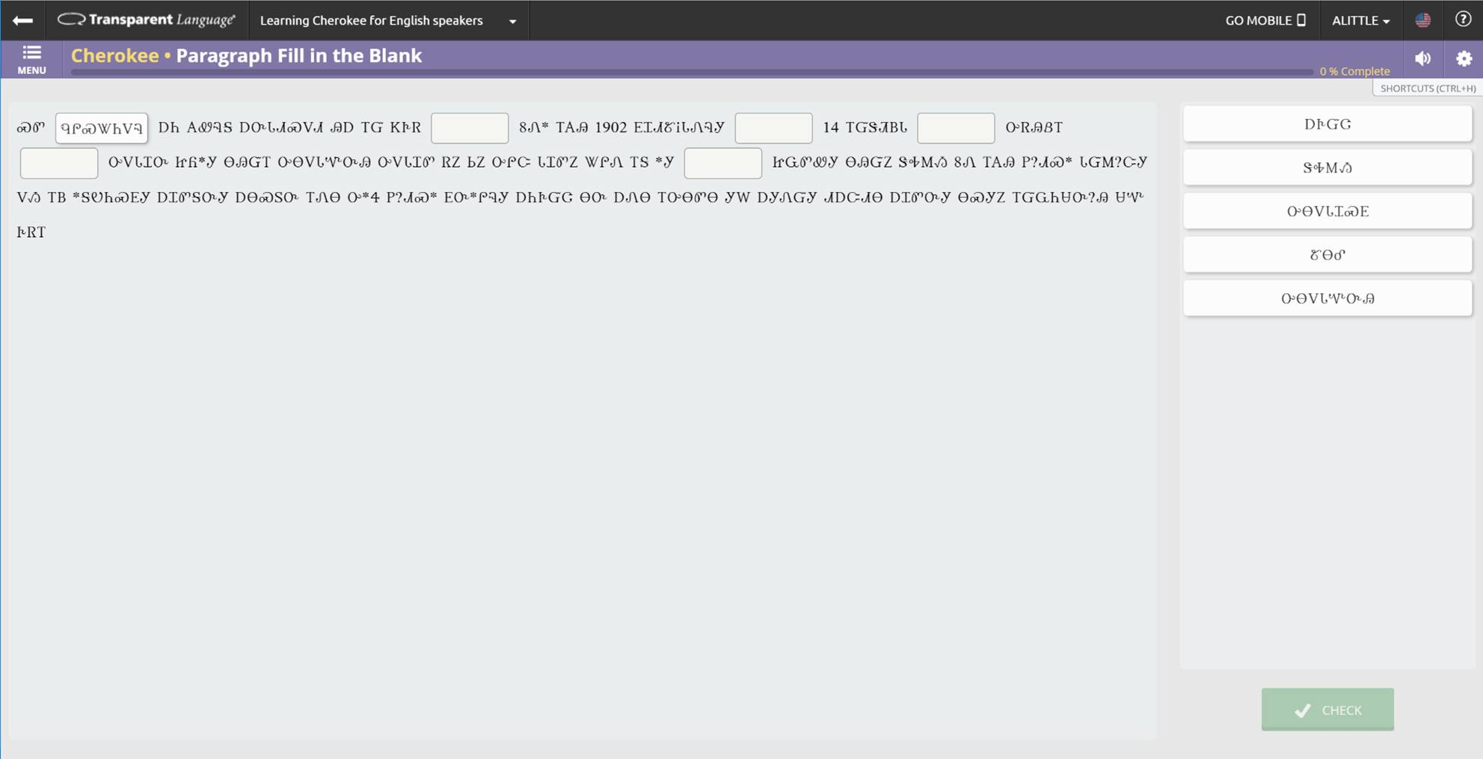

Slide 18
Important Considerations
Consent
Access protocols
Benefits to community
Usability / design
Collaborations with data scientists, teachers, linguists, students!
Volunteers & citizen science

